Slide 1
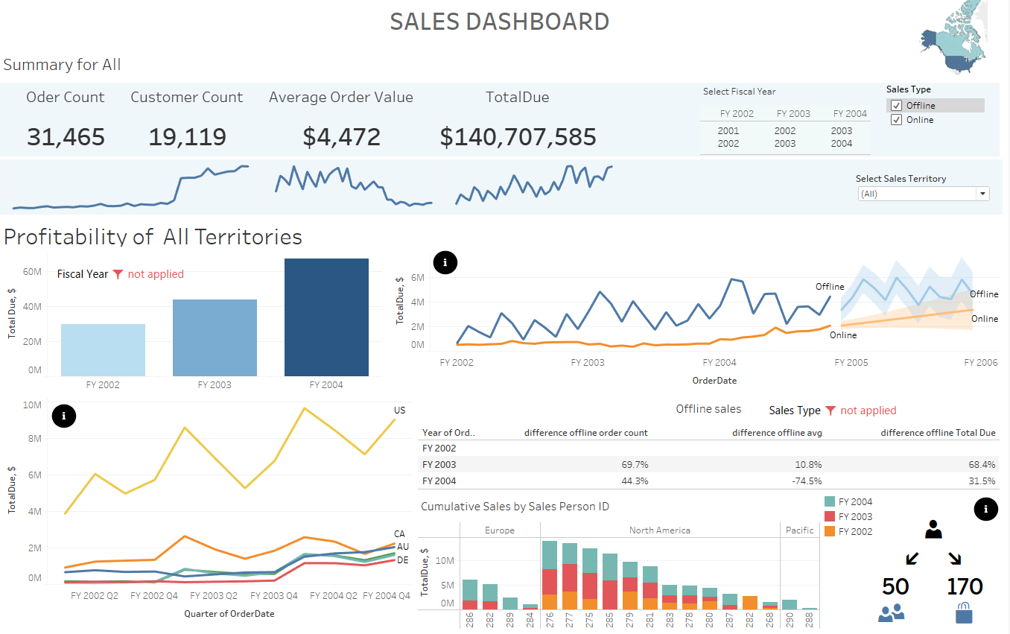
AdwentureWorks SALES
Notes:
Hello, today I want to present AdwentureWorks sales situation. This presentation is prepared for the sales department.

Slide 2
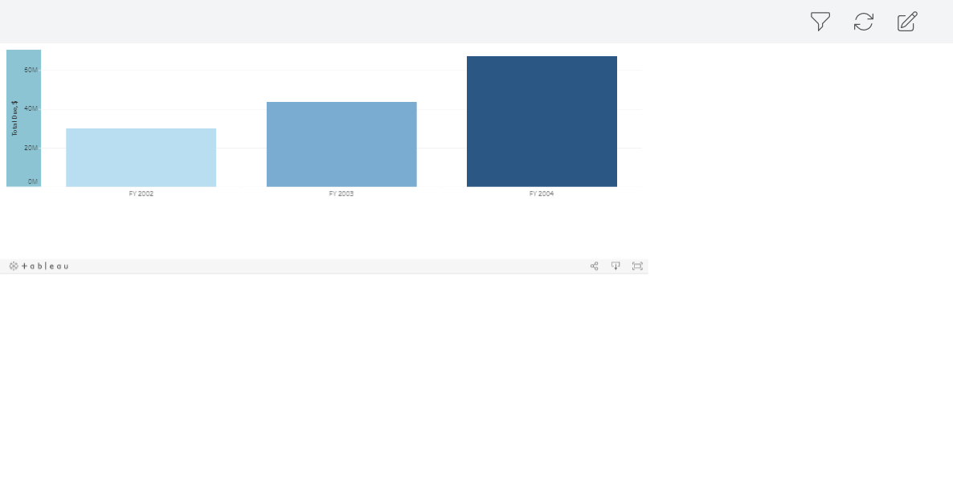
2004 Fiscal Year: The Best Year Yet!
47.85% generated during the 2004 fiscal year
Growth rate of 54%
Notes:
2004 fiscal year was the best fiscal year for the company.
47,85% of the sales ware generated during 2004 fiscal year. 2004 fiscal year grew in 54% in comparison with the previous fiscal year.

Slide 3
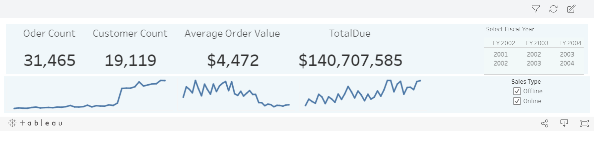
Average Order Amount
Notes:
The average amount per order is 4472 in general. When the average of non online order is 28446 and online - 1173. That is 24 times less.

Slide 4
Below Average Orders
Notes:
There are almost 29 thousand orders are below average. That is 92% of the orders.
!nesuplakti į vieną, šitos skaidrės net nereikia.

Slide 5
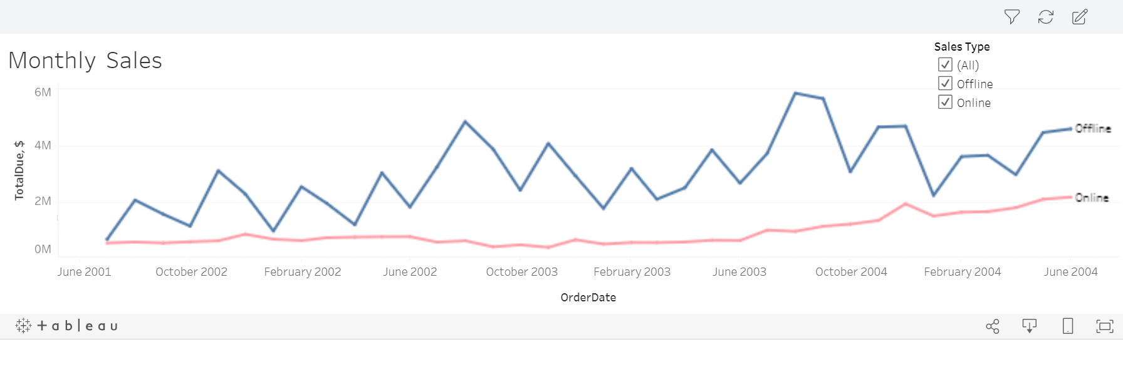
Online vs. Offline Sales
Notes:
Generally, online orders are more frequent but lower in volume
Offline sales are, on average, 30% higher than online sales

Slide 6
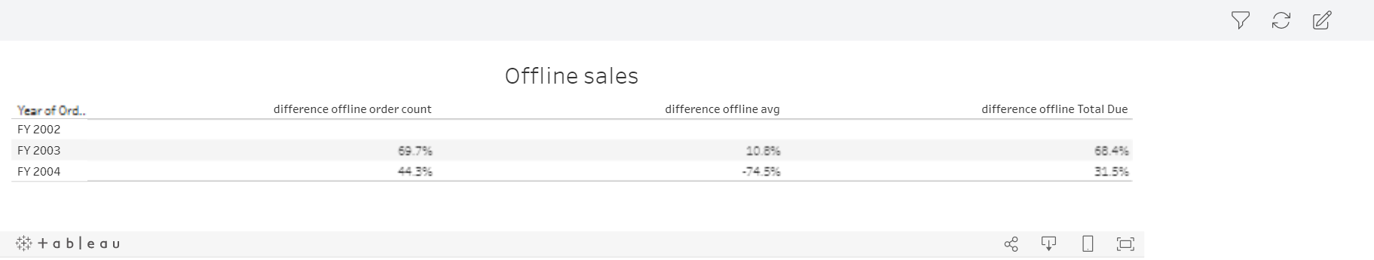
Offline Sales
Notes:
As offline sales are so big in volume, they are valuable for the company. Due to this I want to present them to you in more detail.

Slide 7
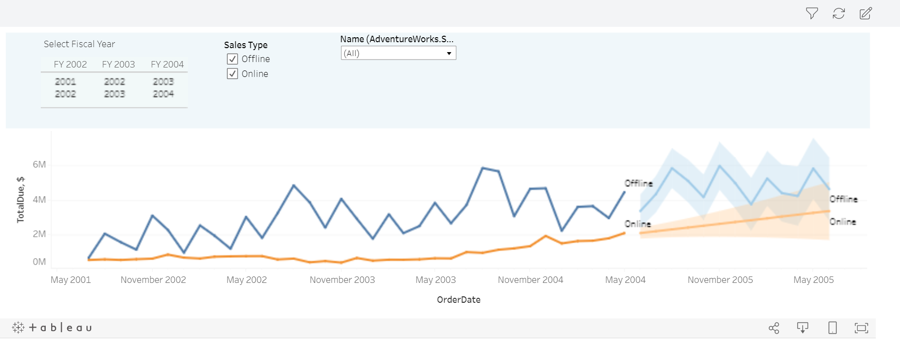
Growth of the Sales
Notes:
Generally, online orders are more frequent but lower in volume
Offline sales are, on average, 30% higher than online sales

Slide 8
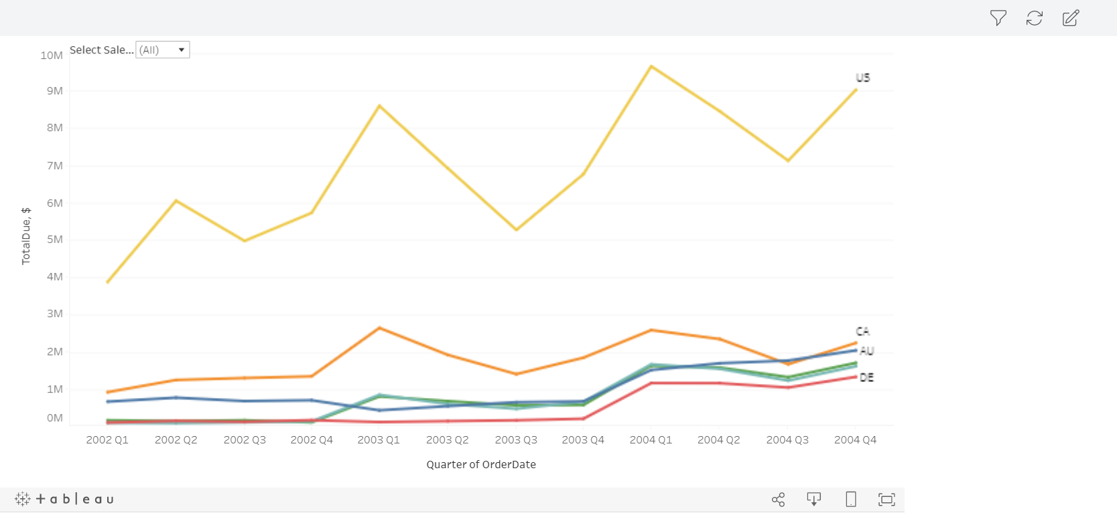
Sales by Region
Notes:
Biggest sales are generated in US region. This region is also the biggest as it consists of of 5 territories. This region is the biggest by customer
and order count as well. Generaly this region is 40% in comparison to all others in total.

Slide 9
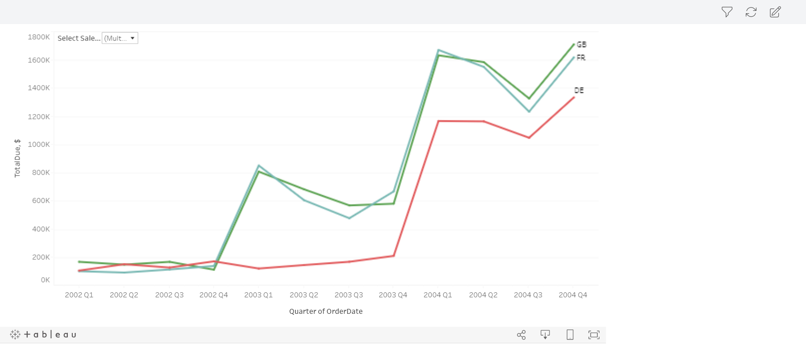
Europe Sales Growth
Notes:
Europe countries began generate bigger sales only when the offline sales start in those countries.
In United Kingdom, France, Germany sales grew approximately twice as offline sales started.

Slide 10
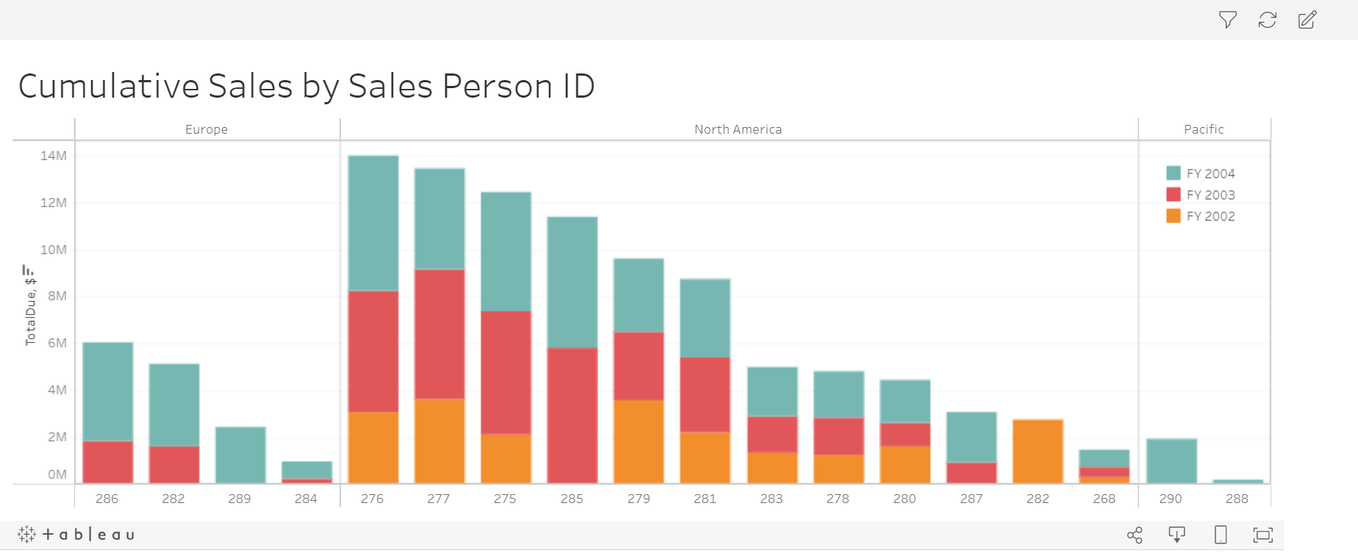
Sales Team Expansion
Notes:
Salespersons deal only with non online buying customers.
In 2002 4 new salespersons were involved into sales, in 2003 - 3 more. There was one drop off in 2002. Each Region has it’s sales manager.
4 top sellers make up 47% of all non online sales.

Slide 11
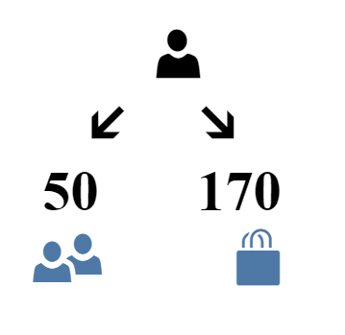
Notes:
One seller is capable to deal with 50 customers and manage 170 orders per year. Today we have 5 such sellers who work in this maximum load.
If we have the growth of 30 percent in sales we may still manage with the same amount of selling persons, but together we would have also a growth in customers for 30 percent, then the situation would change to maximum load of work for all selling persons and this would not be preferable. Due to this we need to thing about expanding the sales team with at least two additional persons.

Slide 12
Actions to take
Orders in of bigger volume
Entering new markets with online sales
Sales team expansion
Collect offline sales data in a distinct manner

